Slide 1
Image Processing
With help of Convolution
Signal and System
section 1.
Ruchit Ghodasara
Viraj Langhnoda
Jay Shapariya
Group 18.

Slide 2
Acknowledgment
To Mr. Grand Sanderson whose video tutorials at MIT on the subject “computational thinking” have helped us a lot. Also to those who made available many library functions for Julia, a new platform for us.
https://youtube.com/playlist?list=PLZHQObOWTQDMp_VZelDYjka8tnXNpXhzJ

Slide 3
What is the task?
Blur the Image…

Slide 4


What is Blur Image?

Slide 5


What is Blur Image?

Slide 6

This is an Image. A Grid of pixels…

Slide 7

Let’s set our Domain…

Slide 8
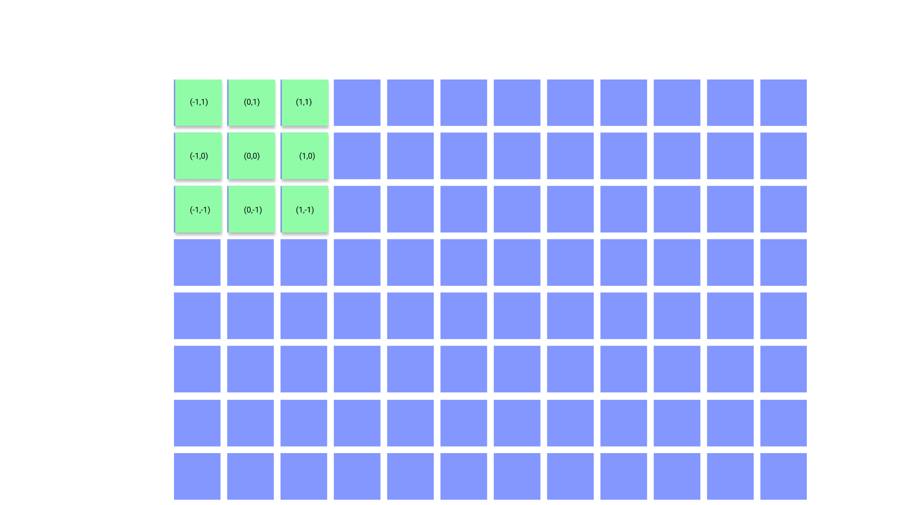
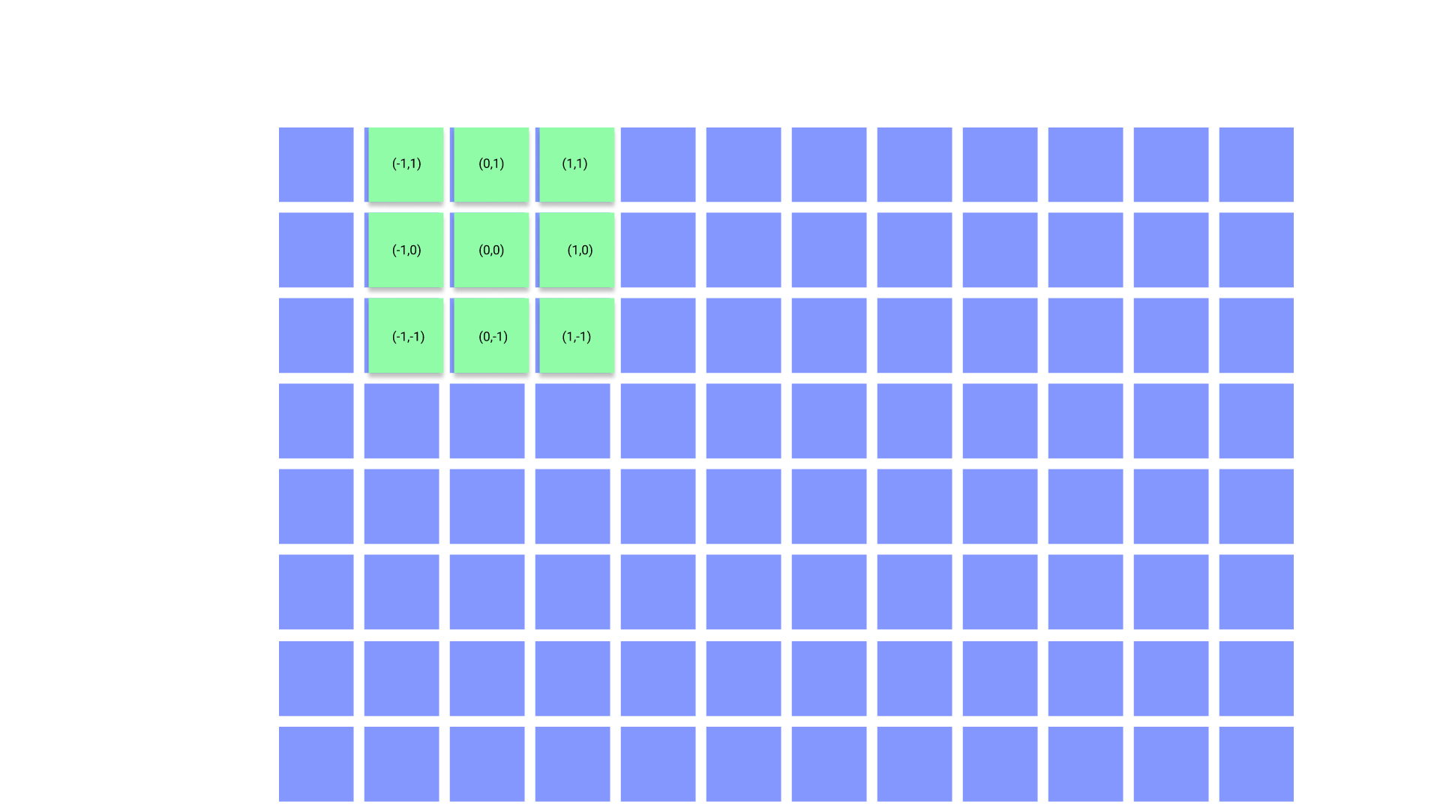
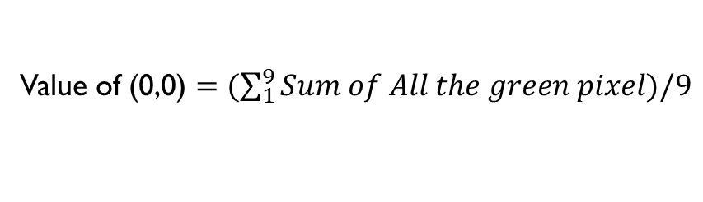
Value of (0,0) $=(\sum_{1}^{9}{Sum of All the green pixel)/9}$
Now calculate this value, and so on…

Slide 9
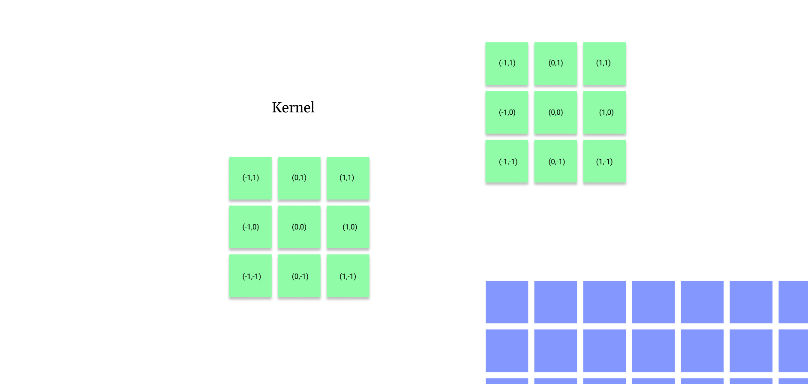
But, How to Program?
We can add different weights to that kernel

Slide 10
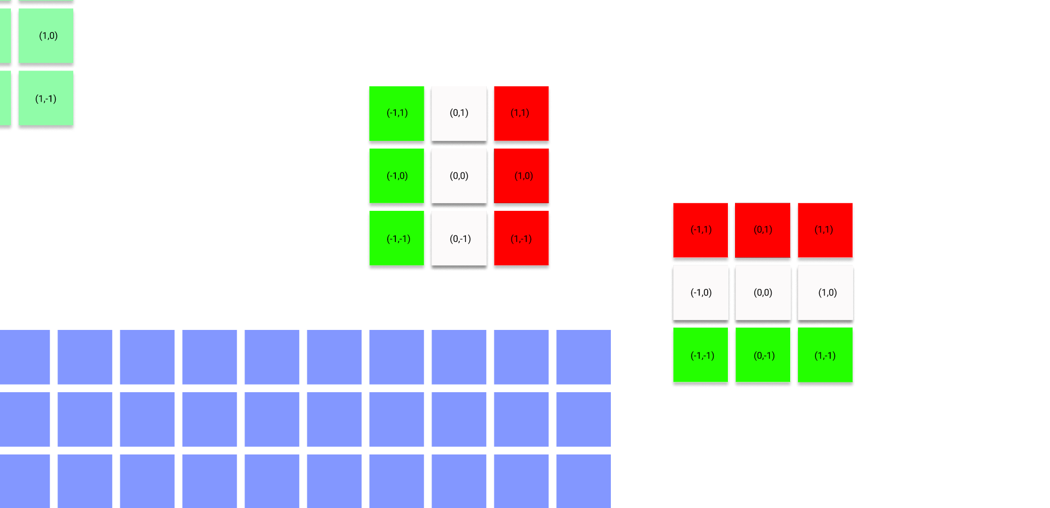
Edge Detection…
Along X axis
Along Y axis
green : + ve
red : - ve
We can add different weights to that kernel

Slide 11
Application of Blur and Sharp images
Blur and Sharp Images are Used in the field of photography and Movie production.
In addition, A blur is a frequent operation that we must execute before moving on to other tasks like edge detection.

Slide 12
Application of Edge Detection
Edge of image is one of the most fundamental and significant features. Edge detection is always one of the classical studying projects of computer vision and image processing field. It is the first step of image analysis and understanding. The purpose of edge detection is to discover the information about the shapes and the reflectance or transmittance in an image. It is one of the fundamental steps in image processing, image analysis, image pattern recognition, and computer vision, as well as in human vision. The correctness and reliability of its results affect directly the comprehension machine system made for objective world.
In areas like image processing, computer vision, and machine vision, edge detection is used for image processing and data extraction. Fingerprint matching, medical diagnosis, and number plate detection are just a few of the areas where edge detection is used.
References:
https://www.mathworks.com/discovery/edge-detection.html
L. Zhai, S. Dong and H. Ma, "Recent Methods and Applications on Image Edge Detection," 2008 International Workshop on Education Technology and Training & 2008 International Workshop on Geoscience and Remote Sensing, 2008, pp. 332-335, doi: 10.1109/ETTandGRS.2008.39.

Slide 13
Code
Other file along with this pdf has been shared that involved Results.
Note attached file is in “.html” format, non executable file. To view output DOWNLOAD THE FILE FROM THE DRIVE AND OPEN IT ON BROWSER. To execute file you may use online cloud service namely “Blinder.”
The reason to not attaching an executable file here is that it may require installation of Julia and Pluto on your pc, most probably your pc would not have it. And without that you may not even see the Output! So, attaching a ‘half Static file.’
File attached : https://drive.google.com/file/d/17AkZYfVHV7w6m_cVXNncT6dSWFewAIOM/view?usp=sharing

